Slide 1
UX Research Study: Logos

Slide 2
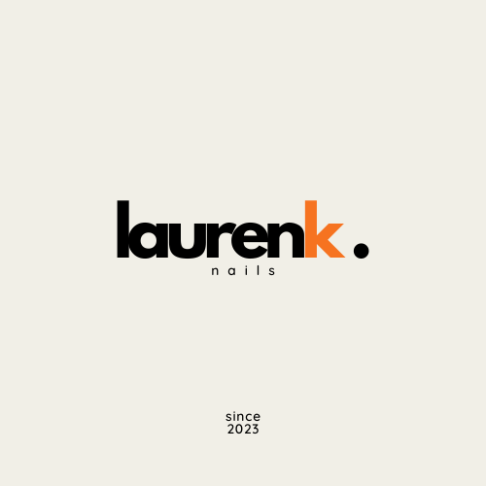
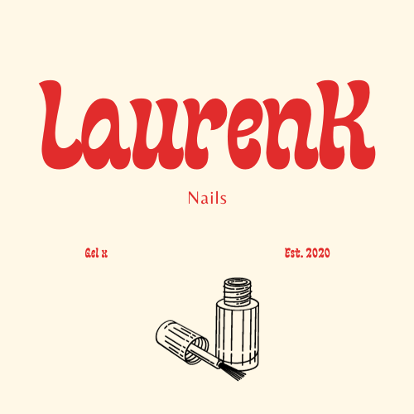
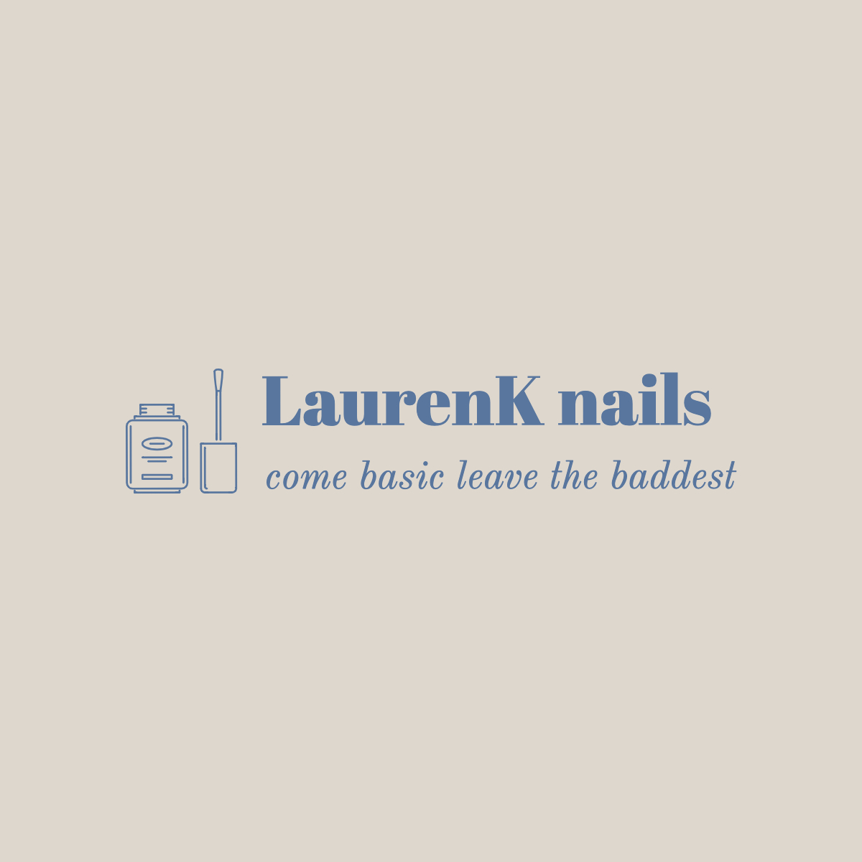
A
B
C

Slide 3
INTRODUCTION TO THE STUDY
Methodology:
In conducting this research, interviews were employed as the primary data collection method. These interviews encompassed inquiries pertaining to visceral, behavioral, and reflective responses.
Objective of the Research:
The aim of this study is to glean valuable insights from users regarding their reactions to various logos. Subsequently, this feedback will inform the development of logos tailored to elicit the most favorable responses from prospective users.

Slide 4
PARTICIPANT INFORMATION
MARIA | BUSE | MICHAEL
Age: 20 Year: Junior Focus: Psychology, with a minor in GSWS and Film Bilingual | Age: 20 Year: Junior Focus: Biology. Speaks Bilingual | Age: 43 Year: "Real Adult with Real Bills" Focus: Art/Design Occupation: Web Designer and Brand Marketer

Slide 5
PARTICIPANT FEEDBACK
MARIA | BUSE | MICHAEL
A: sleek and formal, loves the orange B: very fun, thinks "nails" is too hidden C: chic, the slogan is nice | A: attracted to the orange "k", older audience attraction B: "gel x" and year were too spaced out, a little too decorative C: liked the tight formatting, gets point across, audience too formal | A: very formal for what I'm going for, business like B: my style, likes the color, nails is too hidden, slightly crowded C: clean, needs more

Slide 6
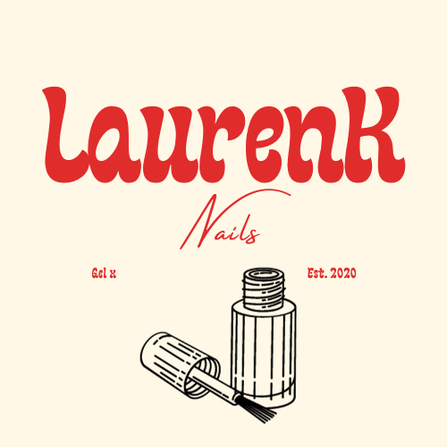
FINAL LOGO
B

Slide 7
APPENDIX
SCRIPT AND TRANSCRIPT

